Slide 1
BA costumer feedback analysis
FROM SKYTRAX REVIEWS
December

Slide 2
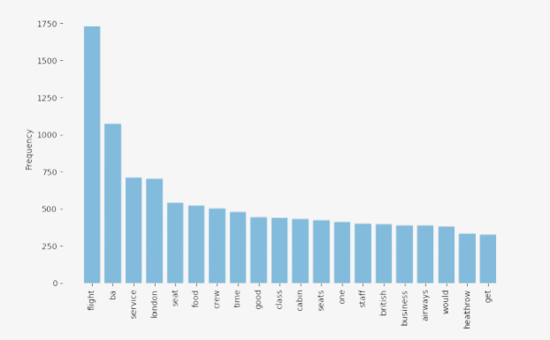
RESULTS
The chart shows the reviews from the costumers for services, crew , seats ,food and overall, there feedback is not satisfactory.
From more than 1000 reviews 526 were positive and 433 were negative and 41 were neutral
55 positive
6 neutral
39 negative

